Slide 1
Transparency Requirements:
What you need to know to make the law work.
Shiry Sapir
September 13, 2022

Slide 2
QUICK LESSON:
Definitions
LEAD-INS

Slide 3
15-102. Parental involvement in the school; definition
A. The governing board, in consultation with parents, teachers and administrators, shall develop and adopt a policy to promote the involvement of parents and guardians of children enrolled in the schools within the school district, including: | 1. A plan for parent participation in the schools that is designed to improve parent and teacher cooperation in such areas as homework, attendance and discipline. The plan shall provide for the administration of a parent-teacher satisfaction survey.
 | 2. Procedures by which parents may learn about the course of study for their children and review learning materials, including the source of any supplemental educational materials.
 | 3. Procedures by which parents who object to any learning material or activity on the basis that the material or activity is harmful may withdraw their children from the activity or from the class or program in which the material is used. Objection to a learning material or activity on the basis that the material or activity is harmful includes objection to the material or activity because it questions beliefs or practices in sex, morality or religion.

Slide 4
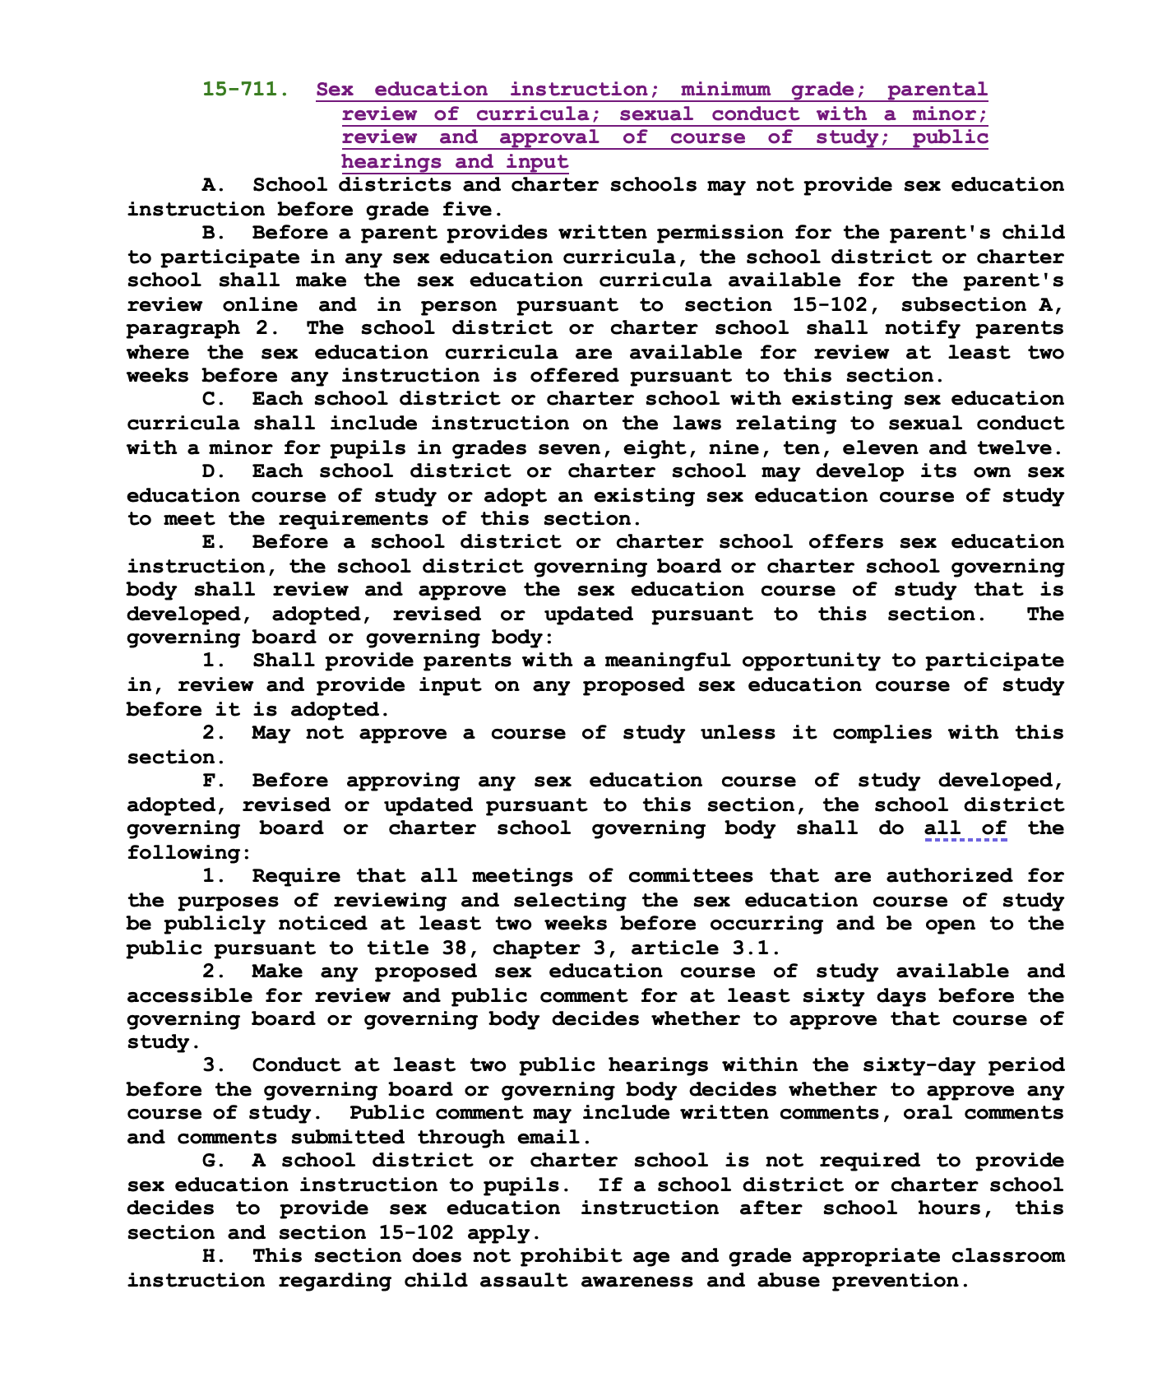
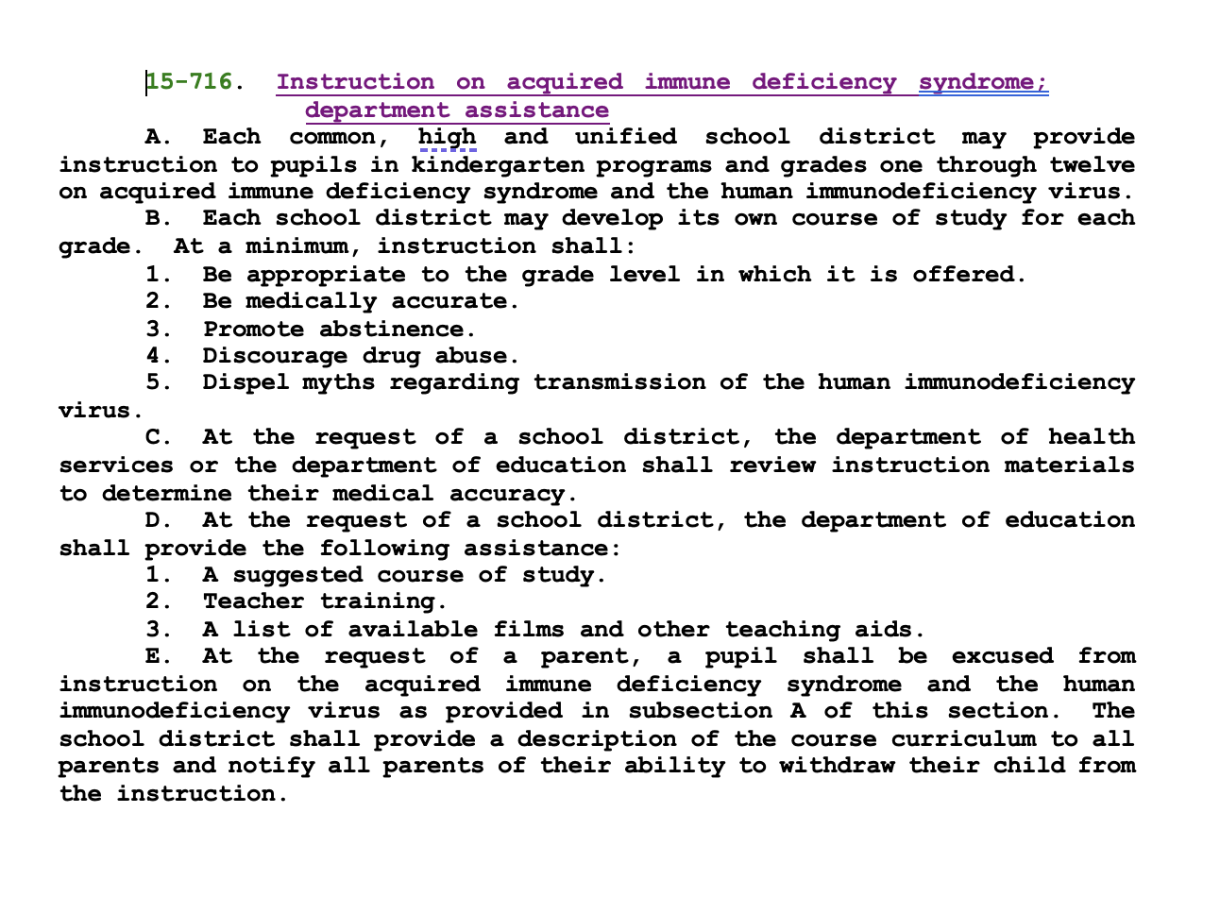
15-102. Parental involvement in the school; definition
A. The governing board, in consultation with parents, teachers and administrators, shall develop and adopt a policy to promote the involvement of parents and guardians of children enrolled in the schools within the school district, including:
4. If a school district offers any sex education curricula pursuant to section 15-711 or 15-716 or pursuant to any rules adopted by the state board of education, procedures to prohibit the school district from providing sex education instruction to a pupil unless the pupil's parent provides written permission for the child to participate in the sex education curricula.

Slide 5
15-102. Parental involvement in the school; definition
A. The governing board, in consultation with parents, teachers and administrators, shall develop and adopt a policy to promote the involvement of parents and guardians of children enrolled in the schools within the school district, including: | 5. Procedures by which parents will be notified in advance of and given the opportunity to opt their children in to any instruction, learning materials or presentations regarding sexuality, in courses other than formal sex education curricula.
 | 6. Procedures by which parents may learn about the nature and purpose of clubs and activities that are part of the school curriculum, extracurricular clubs and activities that have been approved by the school.

Slide 6
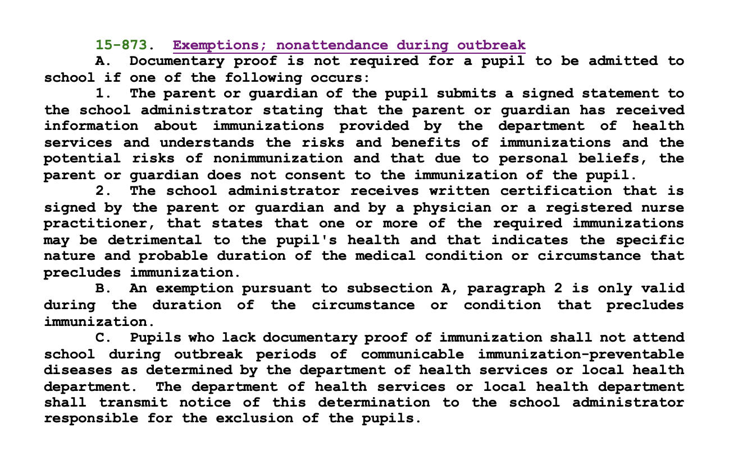
7. Procedures by which parents may learn about parental rights and responsibilities under the laws of this state, including the following:
(a) The right to opt in to a sex education curriculum if one is provided by the school district.
(b) Open enrollment rights pursuant to section 15-816.01.
(c) The right to opt out of assignments pursuant to this section. | You have the right to OPT OUT of assignments
(d) The right to opt out of immunizations pursuant to section 15-873. | Add “Notwithstanding” clause to 15-873.
(e) The promotion requirements prescribed in section 15-701.
(f) The minimum course of study and competency requirements for graduation from high school prescribed in section 15-701.01.
(g) The right to opt out of instruction on acquired immune deficiency syndrome pursuant to section 15-716. | Amend “opt out” to “OPT IN” Amend 15-716 to adjust instruction to not include Kindergarten.
(h) The right to review test results pursuant to section 15-743.
(i) The right to participate in gifted programs pursuant to section 15-779.01.
(j) The right to access instructional materials pursuant to section 15-730.
(k) The right to receive a school report card pursuant to section 15-746.
(l) The attendance requirements prescribed in sections 15-802, 15-803 and 15-821.
(m) The right to public review of courses of study and textbooks pursuant to sections 15-721 and 15-722.
(n) The right to be excused from school attendance for religious purposes pursuant to section 15-806.
(o) Policies related to parental involvement pursuant to this section.
(p) The right to seek membership on school councils pursuant to section 15-351.
(q) Information about the student accountability information system as prescribed in section 15-1041.
(r) The right to access the failing schools tutoring fund pursuant to section 15-241.

Slide 7
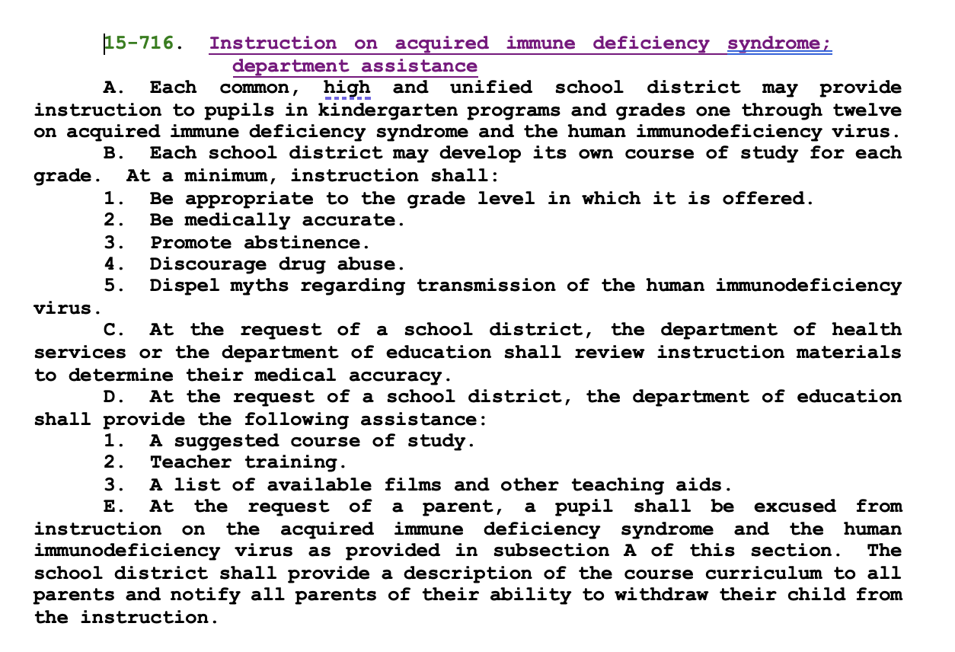
(a) The right to opt in to a sex education curriculum if one is provided by the school district.
(b) Open enrollment rights pursuant to section 15-816.01.
(c) The right to opt out of assignments pursuant to this section. | You have the right to OPT OUT of assignments
(d) The right to opt out of immunizations pursuant to section 15-873. | Add “Notwithstanding” clause to 15-873.
(e) The promotion requirements prescribed in section 15-701.
(f) The minimum course of study and competency requirements for graduation from high school prescribed in section 15-701.01.
(g) The right to opt out of instruction on acquired immune deficiency syndrome pursuant to section 15-716. | Amend “opt out” to “OPT IN” Amend 15-716 to adjust instruction to not include Kindergarten.
(h) The right to review test results pursuant to section 15-743.
(i) The right to participate in gifted programs pursuant to section 15-779.01.

Slide 8
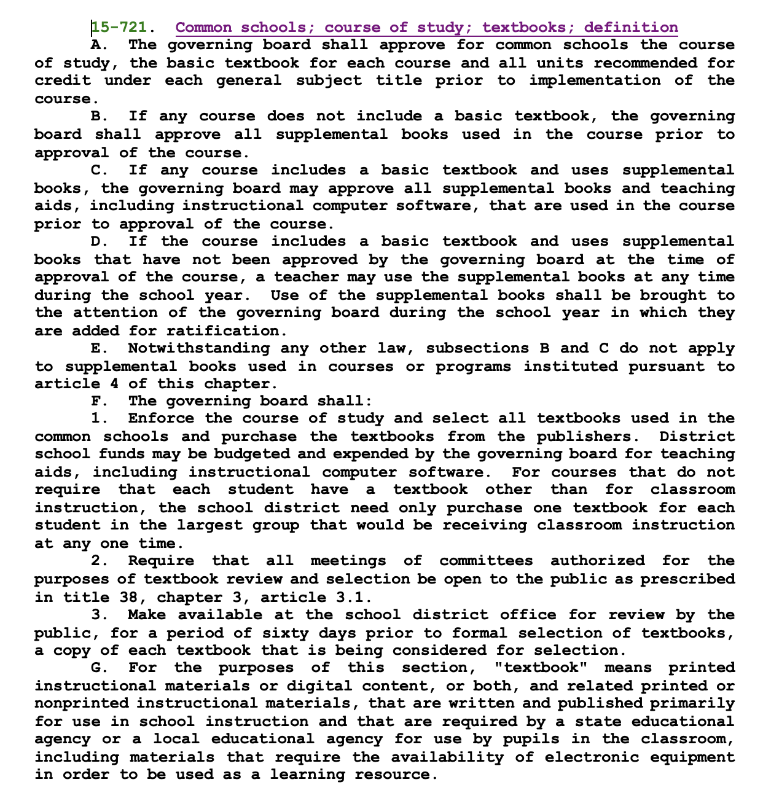
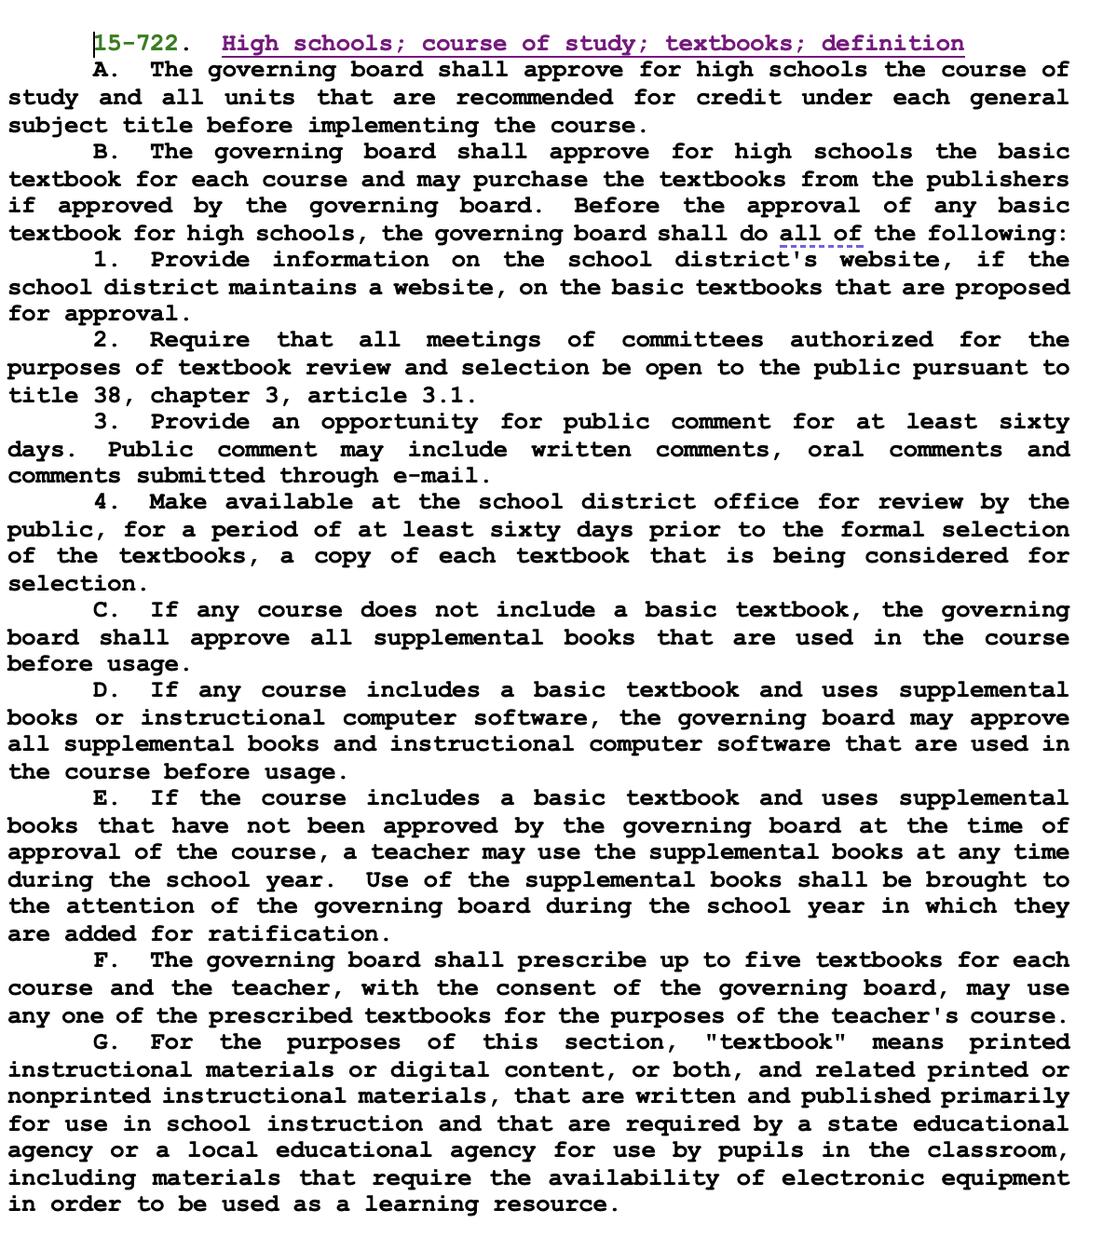
7. Procedures by which parents may learn about parental rights and responsibilities under the laws of this state, including the following:
(h) The right to review test results pursuant to section 15-743.
(i) The right to participate in gifted programs pursuant to section 15-779.01.
(j) The right to access instructional materials pursuant to section 15-730.
(k) The right to receive a school report card pursuant to section 15-746.
(l) The attendance requirements prescribed in sections 15-802, 15-803 and 15-821.
(m) The right to public review of courses of study and textbooks pursuant to sections 15-721 and 15-722.

Slide 9
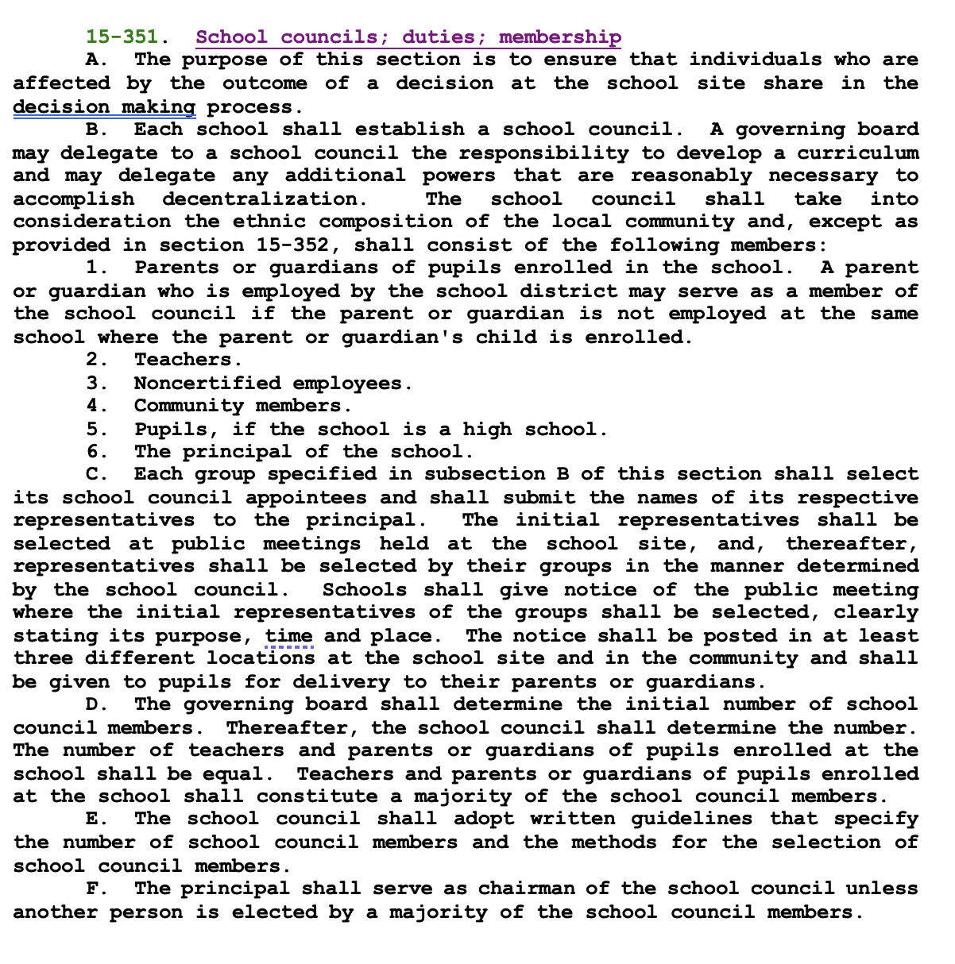
7. Procedures by which parents may learn about parental rights and responsibilities under the laws of this state, including the following:
(o) Policies related to parental involvement pursuant to this section.
(p) The right to seek membership on school councils pursuant to section 15-351.
(q) Information about the student accountability information system as prescribed in section 15-1041.
(r) The right to access the failing schools tutoring fund pursuant to section 15-241.

Slide 10
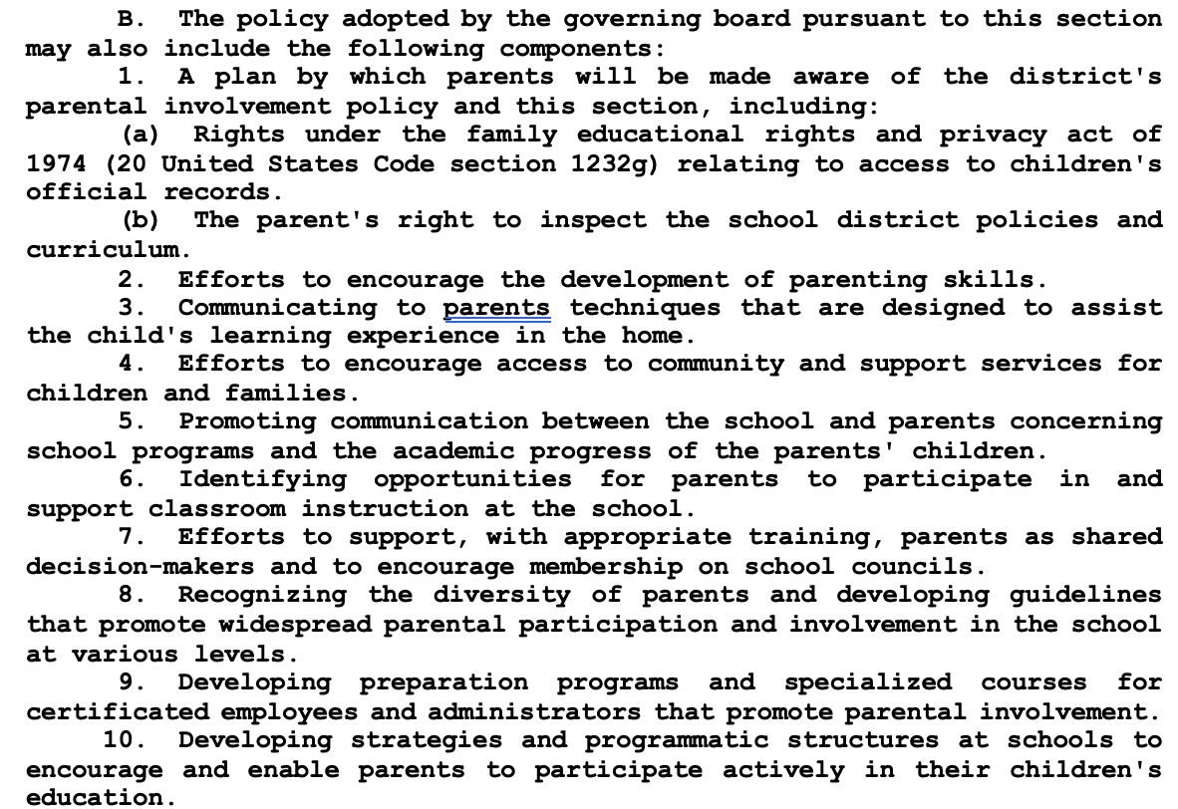
15-102. Parental involvement in the school; definition
B. The policy adopted by the governing board pursuant to this section may SHALL also include the following components: | ASK YOUR SCHOOL BOARD!

Slide 11
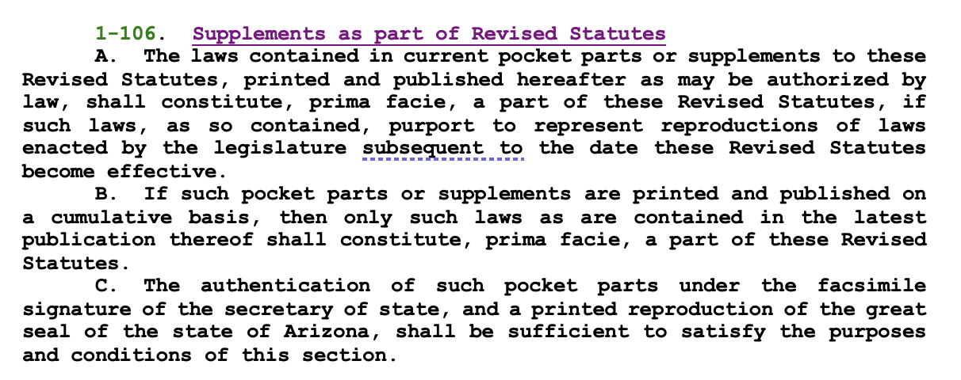
15-602. Parent Bill of Rights
Get familiar with this important law – these are YOUR children, NOT the government’s! | “Parents have the right to direct the education, the upbringing, the moral and religious training of a minor child, and make all medical decisions on behalf of a minor child”

Slide 12
THANK YOU!

